Slide 1


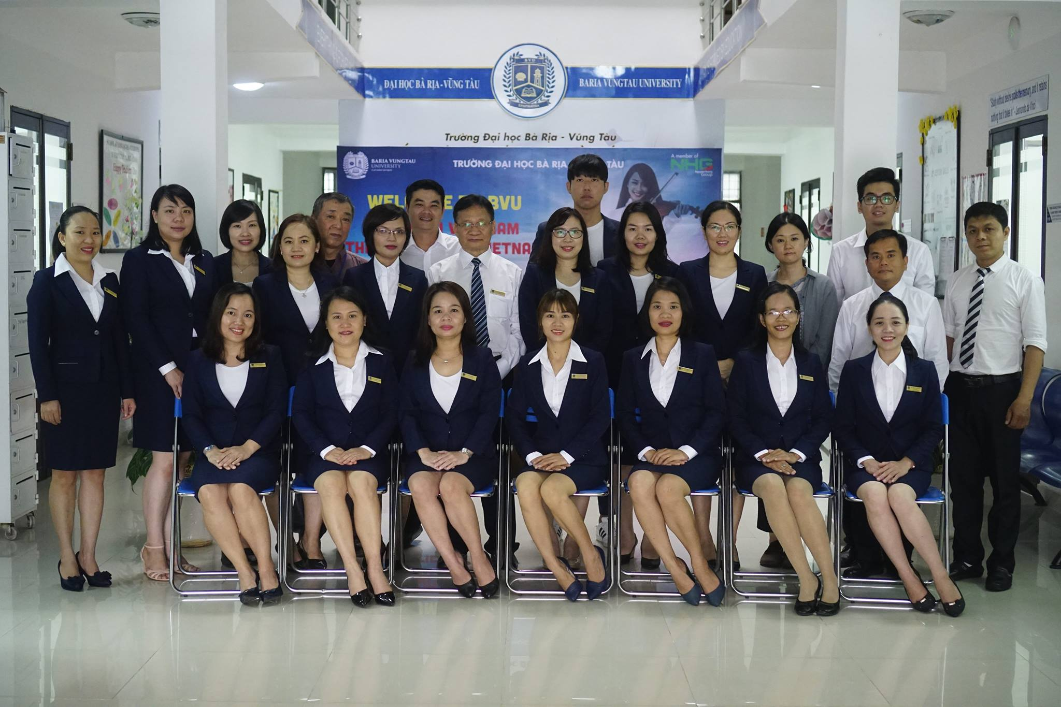

Slide 2

AMERICAN JETSTREAM PRE-INTERMEDIATE B

Slide 3
TEACHER’S PERSONAL INFORMATION
Name: Nguyen Thanh Loan
Facebook: Loan Nguyễn Thanh
Mobile number: 0942 255 937
Email: loannguyenthanh1978@gmail.com

Slide 4
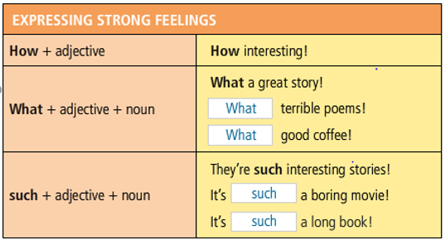
Expressing strong feelings

Slide 5
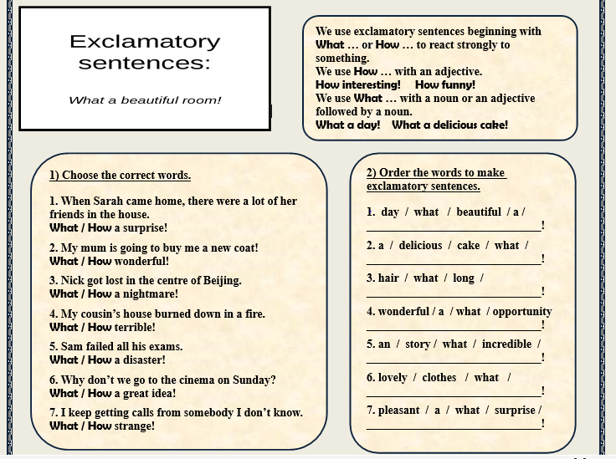

Slide 6
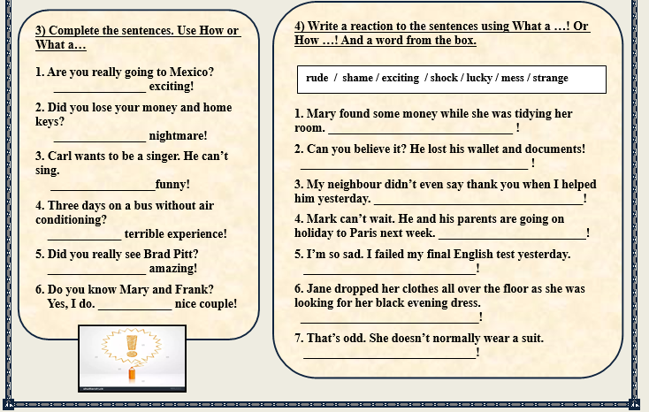

Slide 7
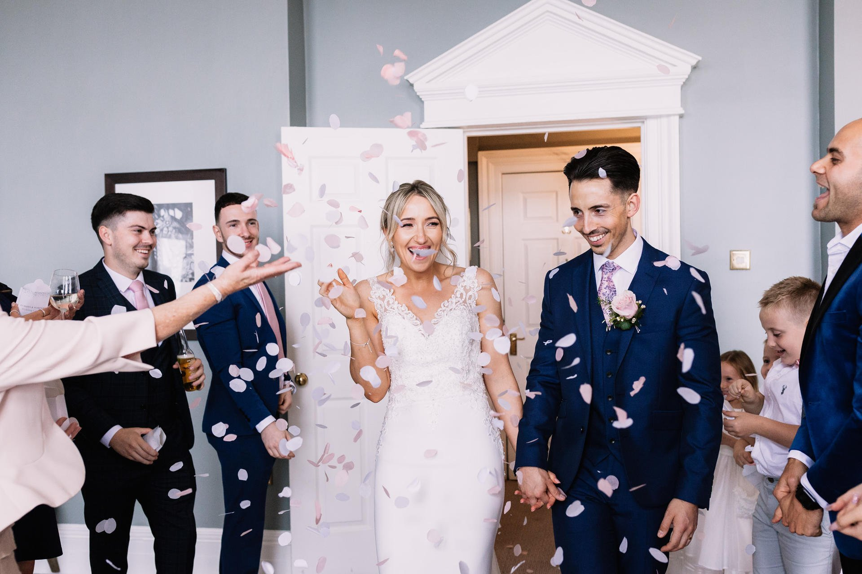
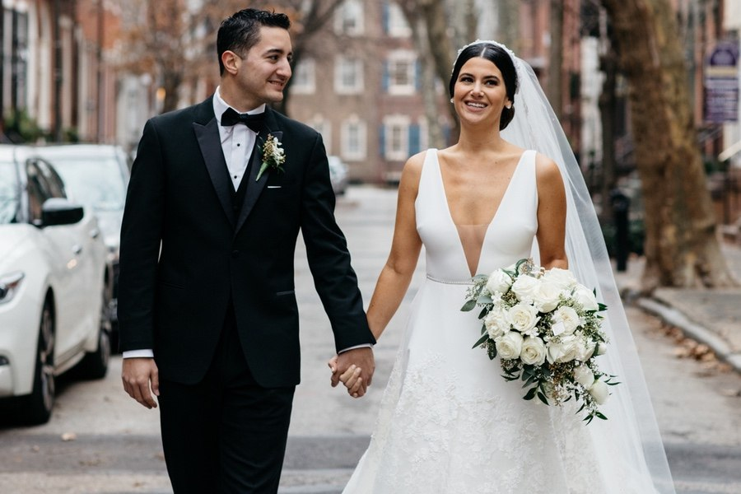
UNIT 12
SPECIAL OCCASIONS
/ˈspeʃl əˈkeɪʒn/
a particular time when something happens

Slide 8
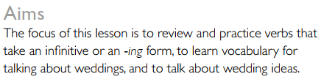
UNIT 12
SPECIAL OCCASIONS
Lesson 1
Making it memorable

Slide 9
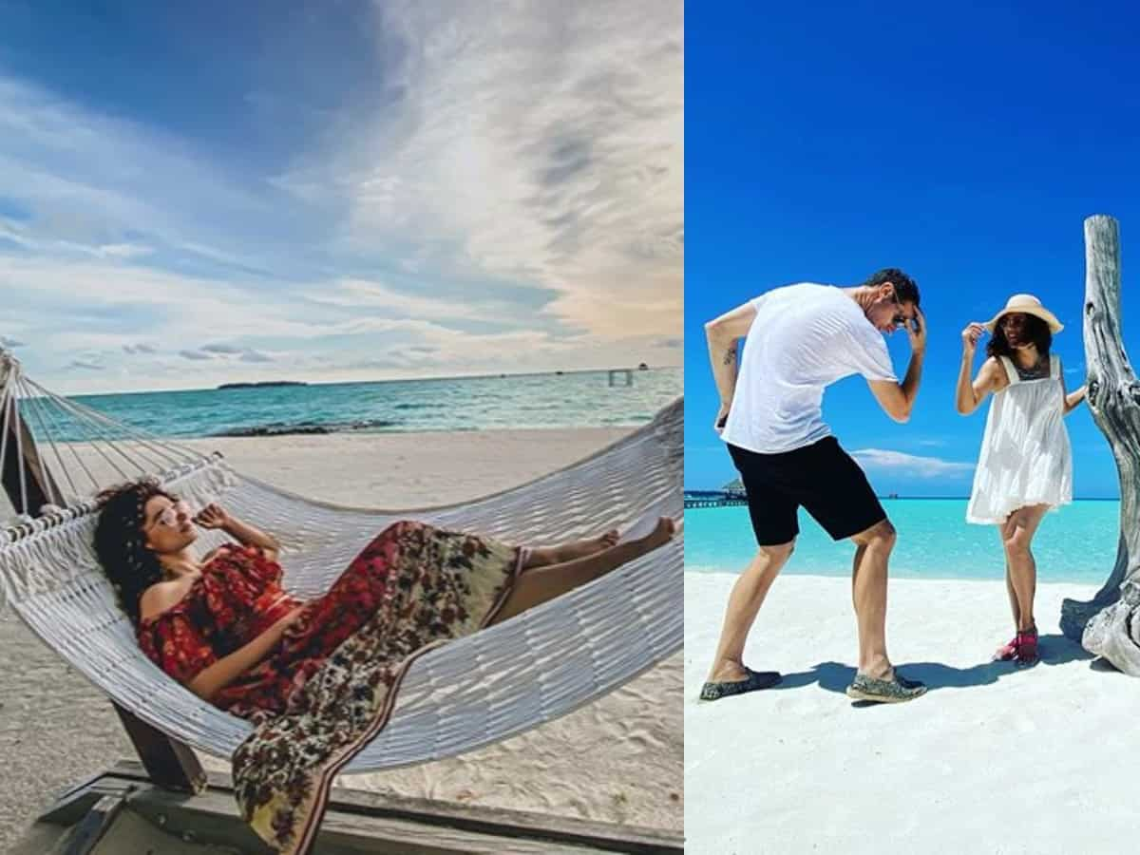
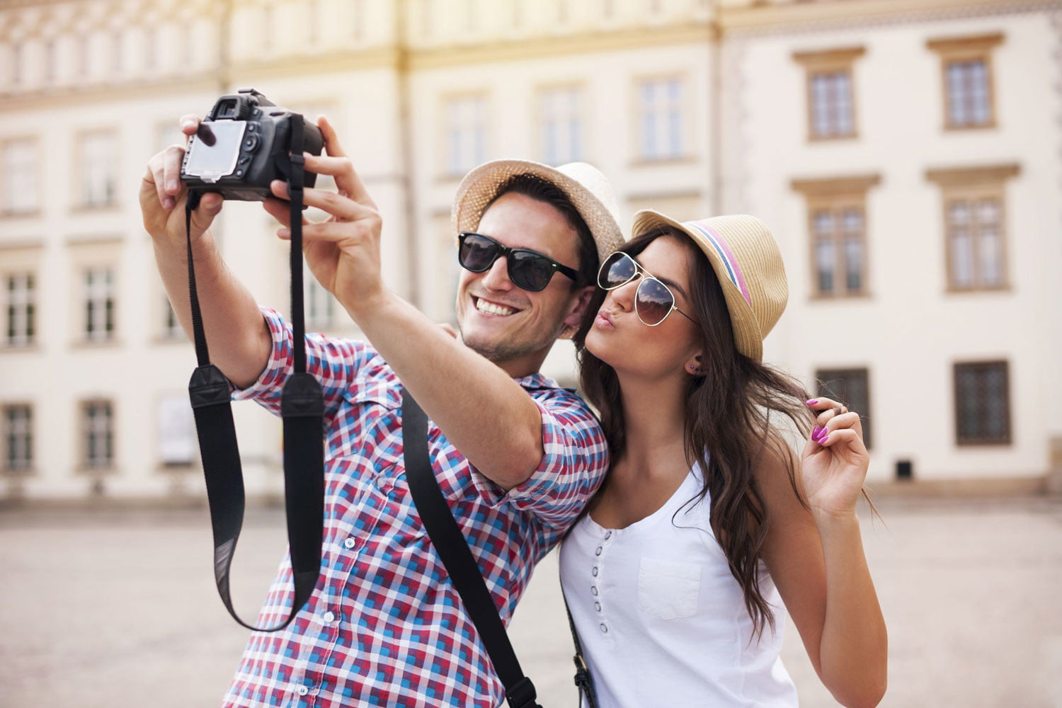
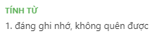
VOCABULARY
Weddings
memorable
worth remembering or easy to remember, especially because of being special or unusual
/ˈmemərəbl/
Ex: The holiday provided many memorable moments..

Slide 10
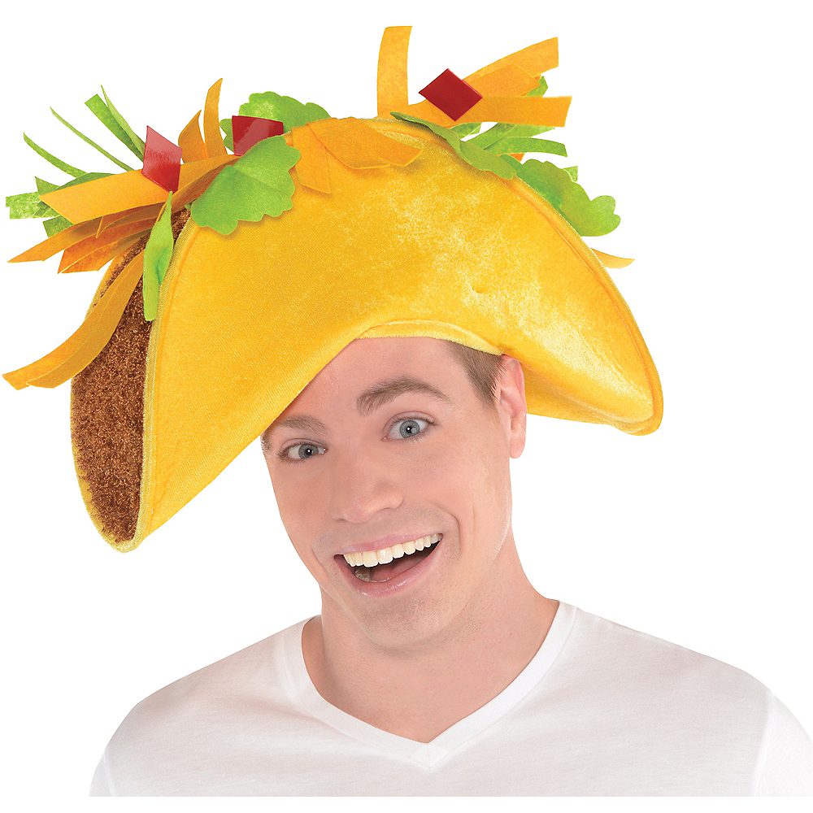
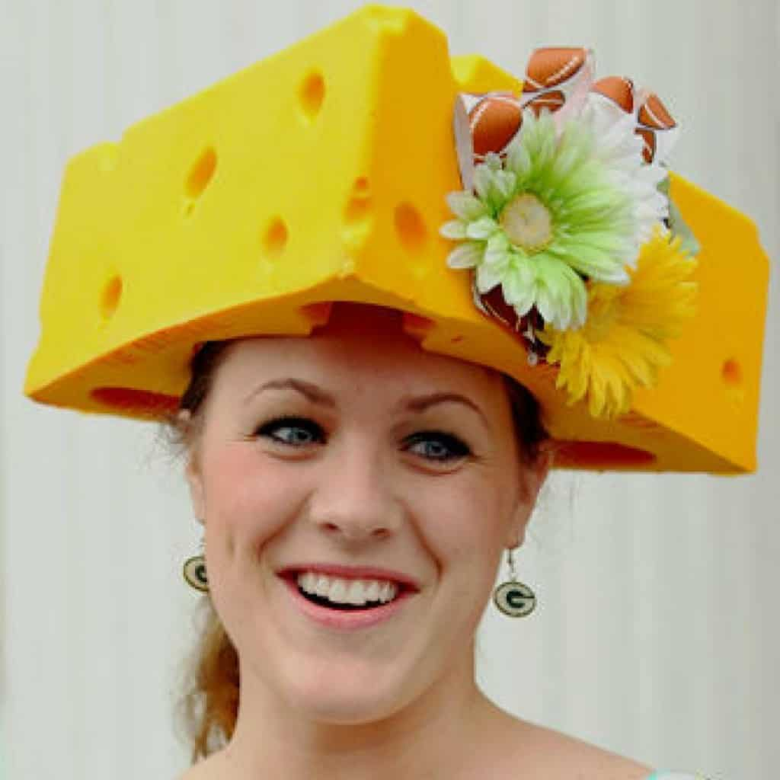
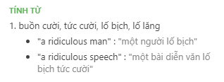
Weddings
VOCABULARY
Ridiculous
very silly or unreasonable
/rɪˈdɪkjələs/
Ex: I look ridiculous in this hat.

Slide 11
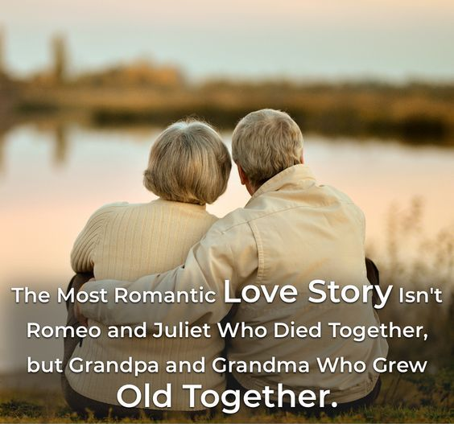
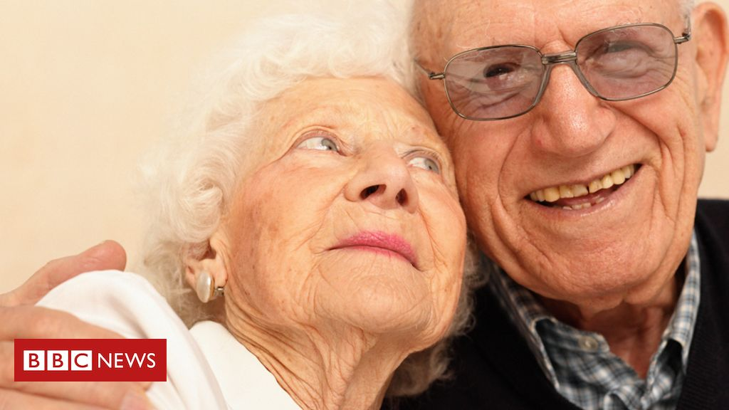
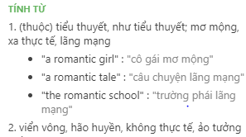
VOCABULARY
Weddings
romantic
showing feelings of love
/rəʊˈmæntɪk/
Ex: You're getting quite romantic in your old age!

Slide 12
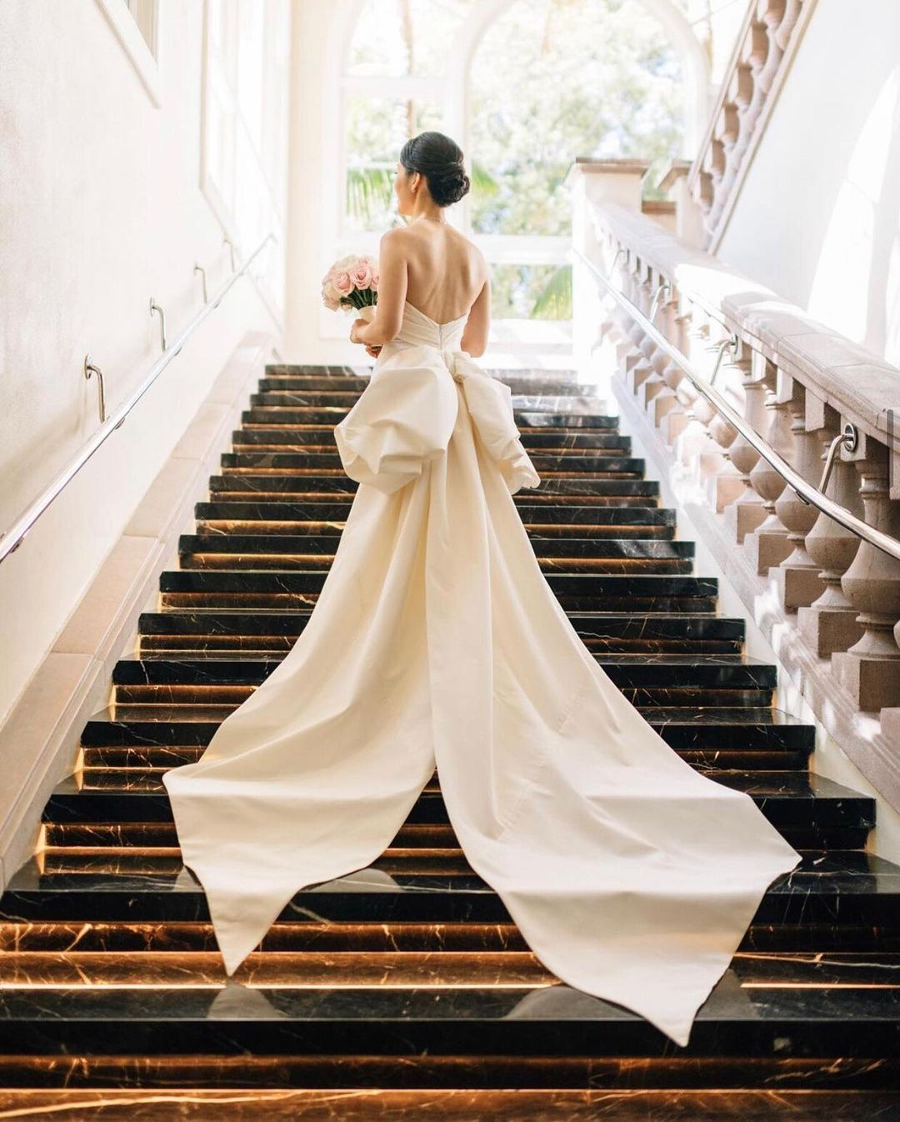
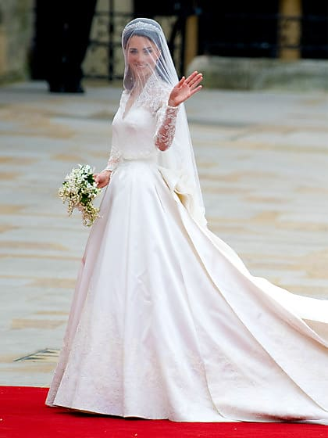
VOCABULARY
Weddings
bride
a woman on her wedding day, or just before or just after it
/braɪd/
Ex: The bride wore an elegant gown of ivory satin.

Slide 13
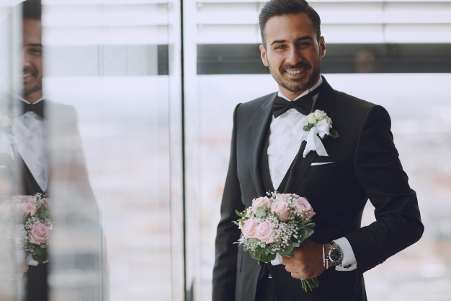
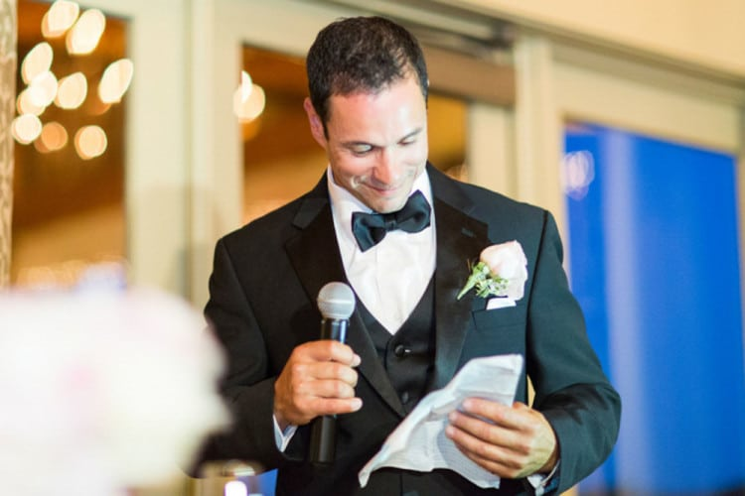
VOCABULARY
Weddings
(bride)groom
a man on his wedding day, or just before or just after it
/ˈbraɪdɡruːm/
Ex: I enjoyed the bridegroom’s speech.

Slide 14
VOCABULARY
Weddings
 | Words | Pronunciation | Definition
1 | ceremony | /ˈserəməni/ | a public or religious occasion that includes a series of formal or traditional actions
2 | celebrate | /ˈselɪbreɪt/ | to show that a day or an event is important by doing something special on it
3 | surprise | /səˈpraɪz/ | cause (someone) to feel mild astonishment or shock.
4 | couple | /ˈkʌpl/ | two people or things
5 | Get married |  | having a husband or wife
6 | afford | /əˈfɔːd/ | to have enough money to be able to buy or do something
7 | Get divorced | /dɪˈvɔːst/ | no longer married because your marriage has been legally ended
8 | fabulous | /ˈfæbjələs/ | extremely good

Slide 15
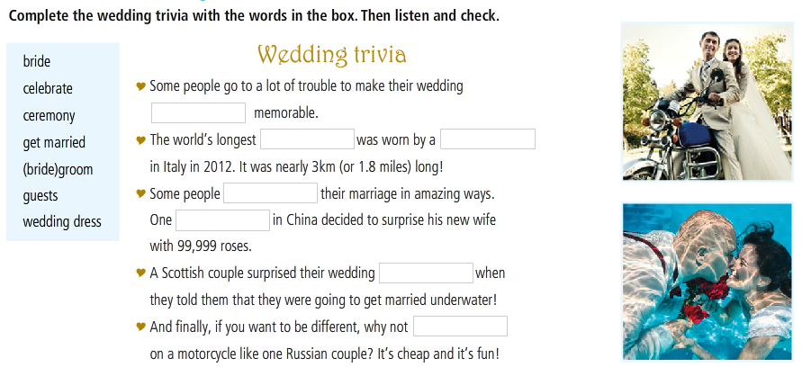






READING
Making it memorable

Slide 16
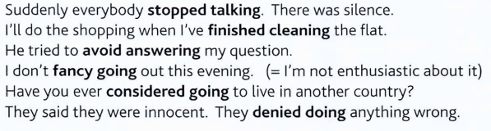





GRAMMAR
Verbs followed by -ING
Stop postpone admit avoid imagine
finish consider deny risk fancy
Enjoy mind suggest

Slide 17
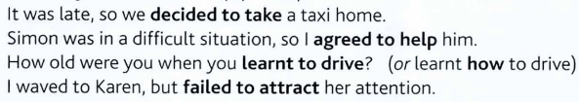
GRAMMAR
Verbs followed by INFINITIVE
offer decide hope deserve promise
agree plan manage afford threaten
refuse arrange fail forget learn

Slide 18
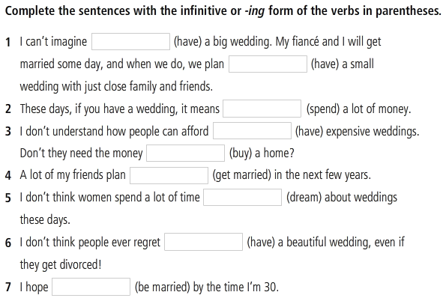
GRAMMAR
Verb + infinitive or ING-form
Activity 3
(p. 48)

Slide 19
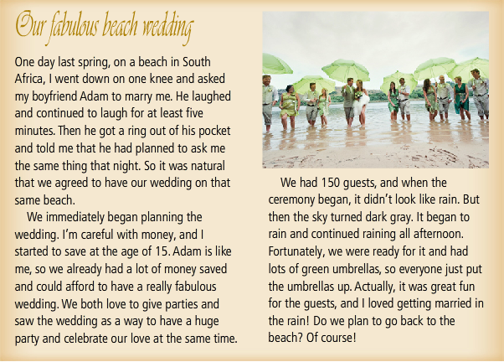
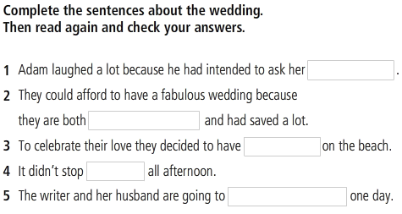
READING

Slide 20
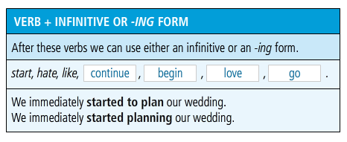
GRAMMAR 2
Verb + infinitive or ING-form

Slide 21
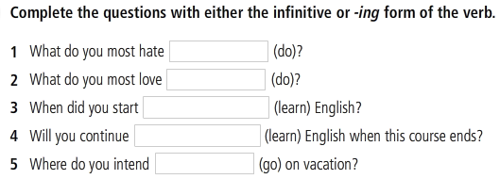
GRAMMAR 2
Verb + infinitive or ING-form

Slide 22
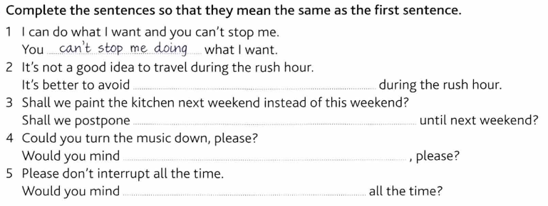
GRAMMAR PRACTICE

Slide 23
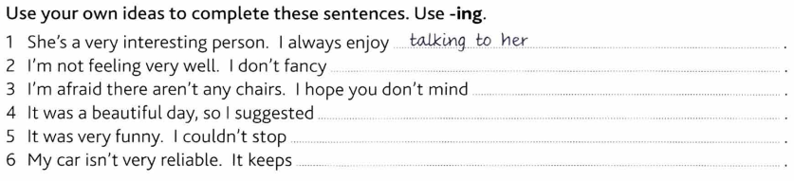
GRAMMAR PRACTICE

Slide 24
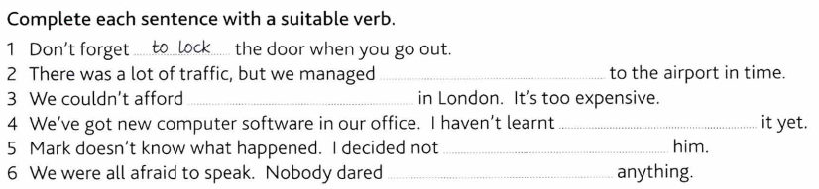
GRAMMAR PRACTICE

Slide 25
REFERENCES
Vocabulary: Wedding
https://www.youtube.com/watch?v=_Uki0qZocjE
Grammar: Verbs followed by infinitive or ing-form
https://www.youtube.com/watch?v=Z3OcDGwW3GA
Listening and watching the video
https://www.youtube.com/watch?v=t-S9FNz1ZRA
https://www.youtube.com/watch?v=PT85QlyEjQI

